Slide 1
Linear Algebra Refresher
CS771: Introduction to Machine Learning
Purushottam Kar

Slide 2
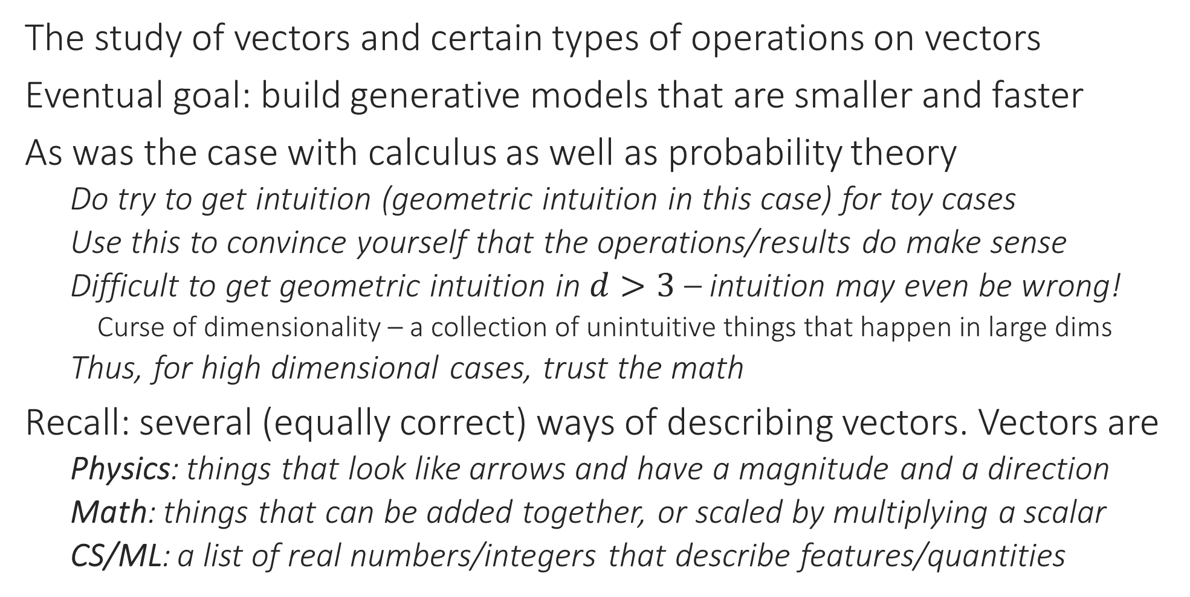
Linear Algebra
The study of vectors and certain types of operations on vectors
Eventual goal: build generative models that are smaller and faster
As was the case with calculus as well as probability theory
Do try to get intuition (geometric intuition in this case) for toy cases
Use this to convince yourself that the operations/results do make sense
Difficult to get geometric intuition in $d>3$ – intuition may even be wrong!
Curse of dimensionality – a collection of unintuitive things that happen in large dims
Thus, for high dimensional cases, trust the math
Recall: several (equally correct) ways of describing vectors. Vectors are
Physics: things that look like arrows and have a magnitude and a direction
Math: things that can be added together, or scaled by multiplying a scalar
CS/ML: a list of real numbers/integers that describe features/quantities

Slide 3


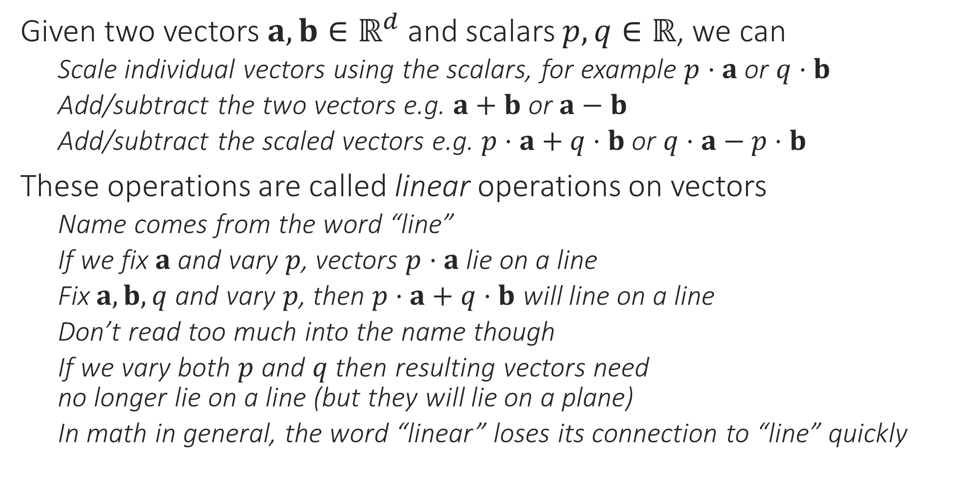



Linear Combinations of Vectors
Given two vectors $a,b∈ℝ^{d}$ and scalars $p,q∈ℝ$, we can
Scale individual vectors using the scalars, for example $p⋅a$ or $q⋅b$
Add/subtract the two vectors e.g. $a+b$ or $a−b$
Add/subtract the scaled vectors e.g. $p⋅a+q⋅b$ or $q⋅a−p⋅b$
These operations are called linear operations on vectors
Name comes from the word “line”
If we fix $a$ and vary $p$, vectors $p⋅a$ lie on a line
Fix $a,b,q$ and vary $p$, then $p⋅a+q⋅b$ will line on a line
Don’t read too much into the name though
If we vary both $p$ and $q$ then resulting vectors need no longer lie on a line (but they will lie on a plane)
In math in general, the word “linear” loses its connection to “line” quickly
$$p⋅a+q⋅b$$
$$q⋅b$$
$$b$$
$p⋅a$
$$a$$

Slide 4


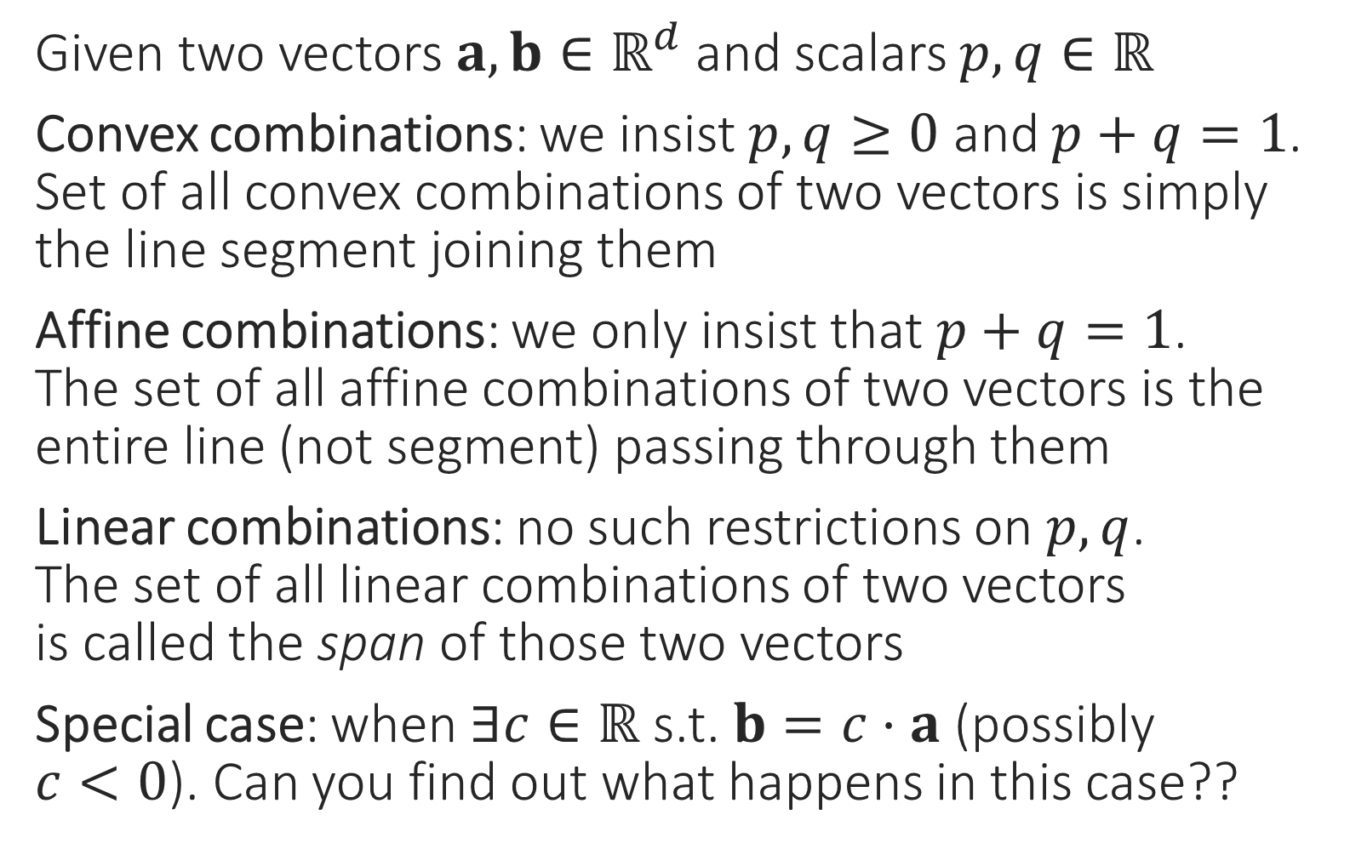
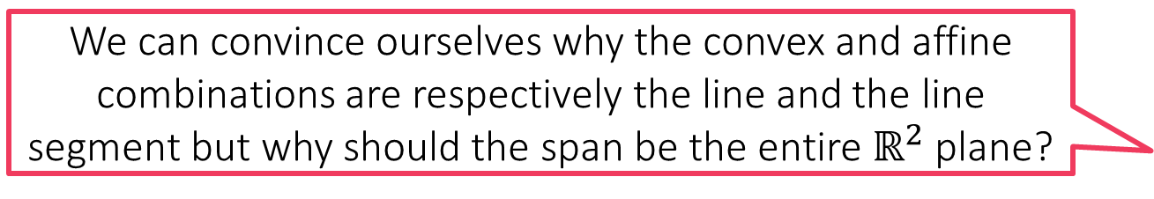
Special kinds of linear combinations
We can convince ourselves why the convex and affine combinations are respectively the line and the line segment but why should the span be the entire $ℝ^{2}$ plane?
Given two vectors $a,b∈ℝ^{d}$ and scalars $p,q∈ℝ$
Convex combinations: we insist $p,q≥0$ and $p+q=1$. Set of all convex combinations of two vectors is simply the line segment joining them
Affine combinations: we only insist that $p+q=1$. The set of all affine combinations of two vectors is the entire line (not segment) passing through them
Linear combinations: no such restrictions on $p,q$. The set of all linear combinations of two vectors is called the span of those two vectors
Special case: when $∃c∈ℝ$ s.t. $b=c⋅a$ (possibly $c<0$). Can you find out what happens in this case??
Let us study these in more detail to find out
What if we have more than two points. How are these defined then?
$$b$$
$$a$$

Slide 5

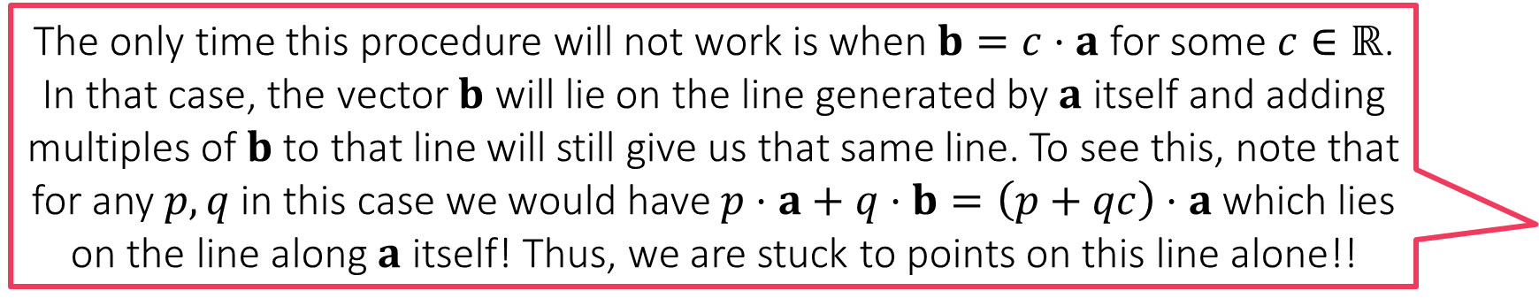
Span of Vectors
The only time this procedure will not work is when $b=c⋅a$ for some $c∈ℝ$. In that case, the vector $b$ will lie on the line generated by $a$ itself and adding multiples of $b$ to that line will still give us that same line. To see this, note that for any $p,q$ in this case we would have $p⋅a+q⋅b=\left(p+qc\right)⋅a$ which lies on the line along $a$ itself! Thus, we are stuck to points on this line alone!!
Span of $a,b$: the set of all vectors that can be obtained by scaling the two vectors using (possibly negative) scalars $p,q$ and adding them
Trick: First set $q=0$ and see what happens when we vary only $p$
$p⋅a$ for all values of $p$ gives us all vectors on the line along $a$
Now let see add $b$ and see the set of possible vectors of the form $p⋅a+b$
This means that the set of all vectors of the form $p⋅a+q⋅b$ where $q$ is varied as well can be got simply by sweeping this line
We can convince ourselves that every point in $ℝ^{2}$ can be reached this way which is why span is $ℝ^{2}$
$$b$$
$$a$$

Slide 6

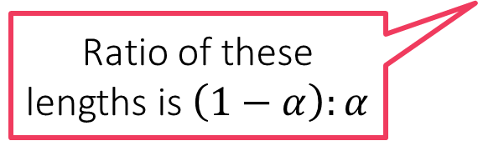


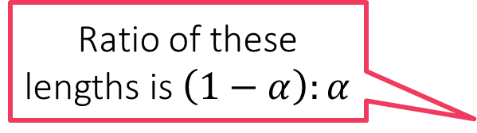
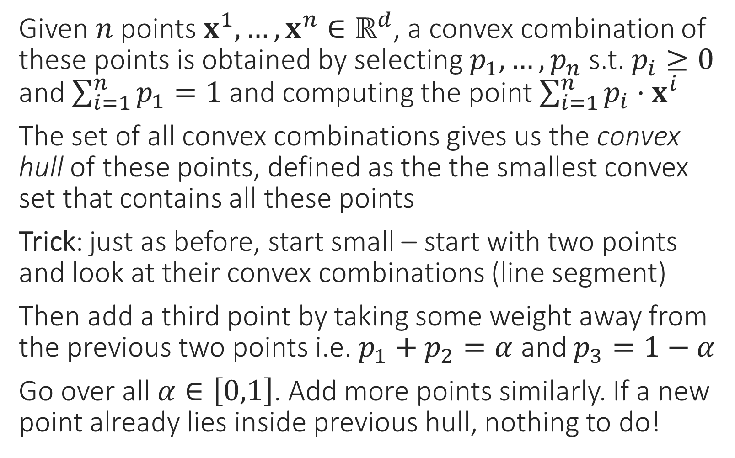






Combinations of More than 2 Vectors
It does not matter in which order do you consider the points. Eventually you will land up with the same convex hull. This claim requires a proof which is beyond the scope of CS771
Given $n$ points $x^{1},…,x^{n}∈ℝ^{d}$, a convex combination of these points is obtained by selecting $p_{1},…,p_{n}$ s.t. $p_{i}≥0$ and $\sum_{i=1}^{n}{p_{1}}=1$ and computing the point $\sum_{i=1}^{n}{p_{i}⋅x^{i}}$
The set of all convex combinations gives us the convex hull of these points, defined as the the smallest convex set that contains all these points
Trick: just as before, start small – start with two points and look at their convex combinations (line segment)
Then add a third point by taking some weight away from the previous two points i.e. $p_{1}+p_{2}=α$ and $p_{3}=1−α$
Go over all $α∈\left[0,1\right]$. Add more points similarly. If a new point already lies inside previous hull, nothing to do!
Ratio of these lengths is $\left(1−α\right):α$
$$1−α$$
$$1−α$$
$$α$$
$$1−α$$
$$1−α$$
$$α$$
$$α$$
$$1−α$$
$$α$$
Ratio of these lengths is $\left(1−α\right):α$
$$α$$

Slide 7

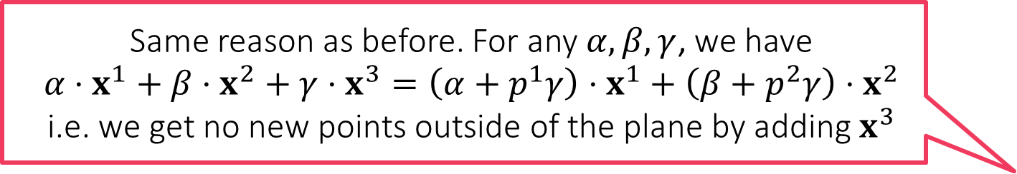

Span of More than Two Vectors
Same reason as before. For any $α,β,γ$, we have $$α⋅x^{1}+β⋅x^{2}+γ⋅x^{3}=\left(α+p^{1}γ\right)⋅x^{1}+\left(β+p^{2}γ\right)⋅x^{2}$$ i.e. we get no new points outside of the plane by adding $x^{3}$
Let us consider three vectors in 3 dimensions
With two vectors (not multiples of each other), we already saw that entire $ℝ^{2}$ is covered so adding more vectors in 2 dims is not interesting anymore
Trick: start with span of one vector $x^{1}$: a line
Add a new vector $x^{2}$: causes the line to move about and become a plane (flat sheet in 3D)
Add a new vector $x^{3}$: causes the sheet to move about and cover entire $ℝ^{3}$
If $x^{3}$ had been expressible as a comb of the previous 2 vectors i.e. $x^{3}=p^{1}⋅x^{1}+p^{2}⋅x^{2}$ for some $p^{1},p^{2}$, then would not cover $ℝ^{3}$
Yet again, it does not matter in which order do you consider the points. Eventually you will land up with the same span. This claim requires a proof which is beyond the scope of CS771
Affine combinations of more than two vectors can also produce planes/hyperplanes. We will not require affine combinations much in our discussions so we are not going into details of those here

Slide 8
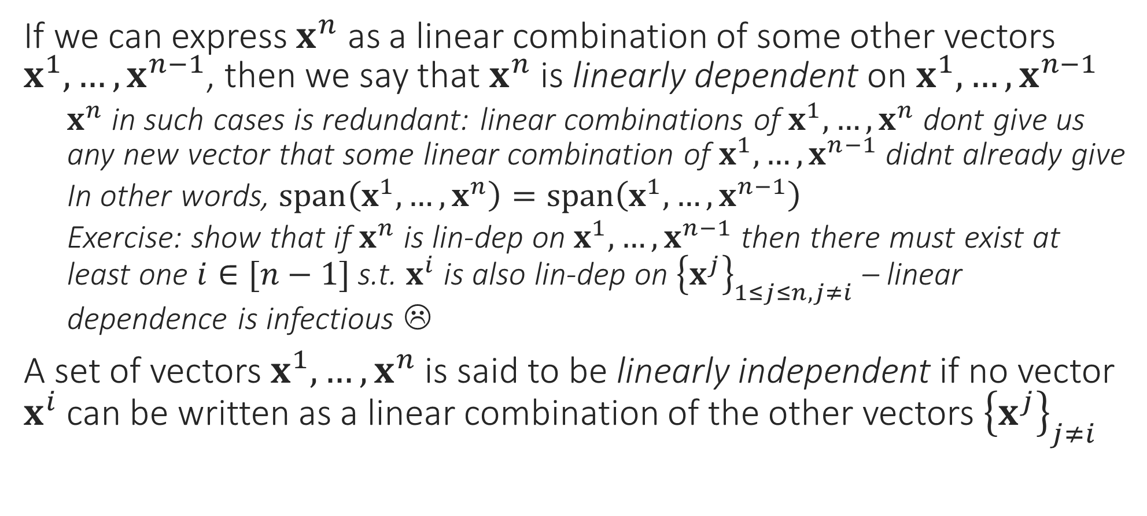
Dependence and Independence
If we can express $x^{n}$ as a linear combination of some other vectors $x^{1},…,x^{n−1}$, then we say that $x^{n}$ is linearly dependent on $x^{1},…,x^{n−1}$
$x^{n}$ in such cases is redundant: linear combinations of $x^{1},…,x^{n}$ dont give us any new vector that some linear combination of $x^{1},…,x^{n−1}$ didnt already give
In other words, $span\left(x^{1},…,x^{n}\right)=span\left(x^{1},…,x^{n−1}\right)$
Exercise: show that if $x^{n}$ is lin-dep on $x^{1},…,x^{n−1}$ then there must exist at least one $i∈[n−1]$ s.t. $x^{i}$ is also lin-dep on ${\left\{x^{j}\right\}}_{1≤j≤n,j≠i}$ – linear dependence is infectious ☹
A set of vectors $x^{1},…,x^{n}$ is said to be linearly independent if no vector $x^{i}$ can be written as a linear combination of the other vectors ${\left\{x^{j}\right\}}_{j≠i}$

Slide 9
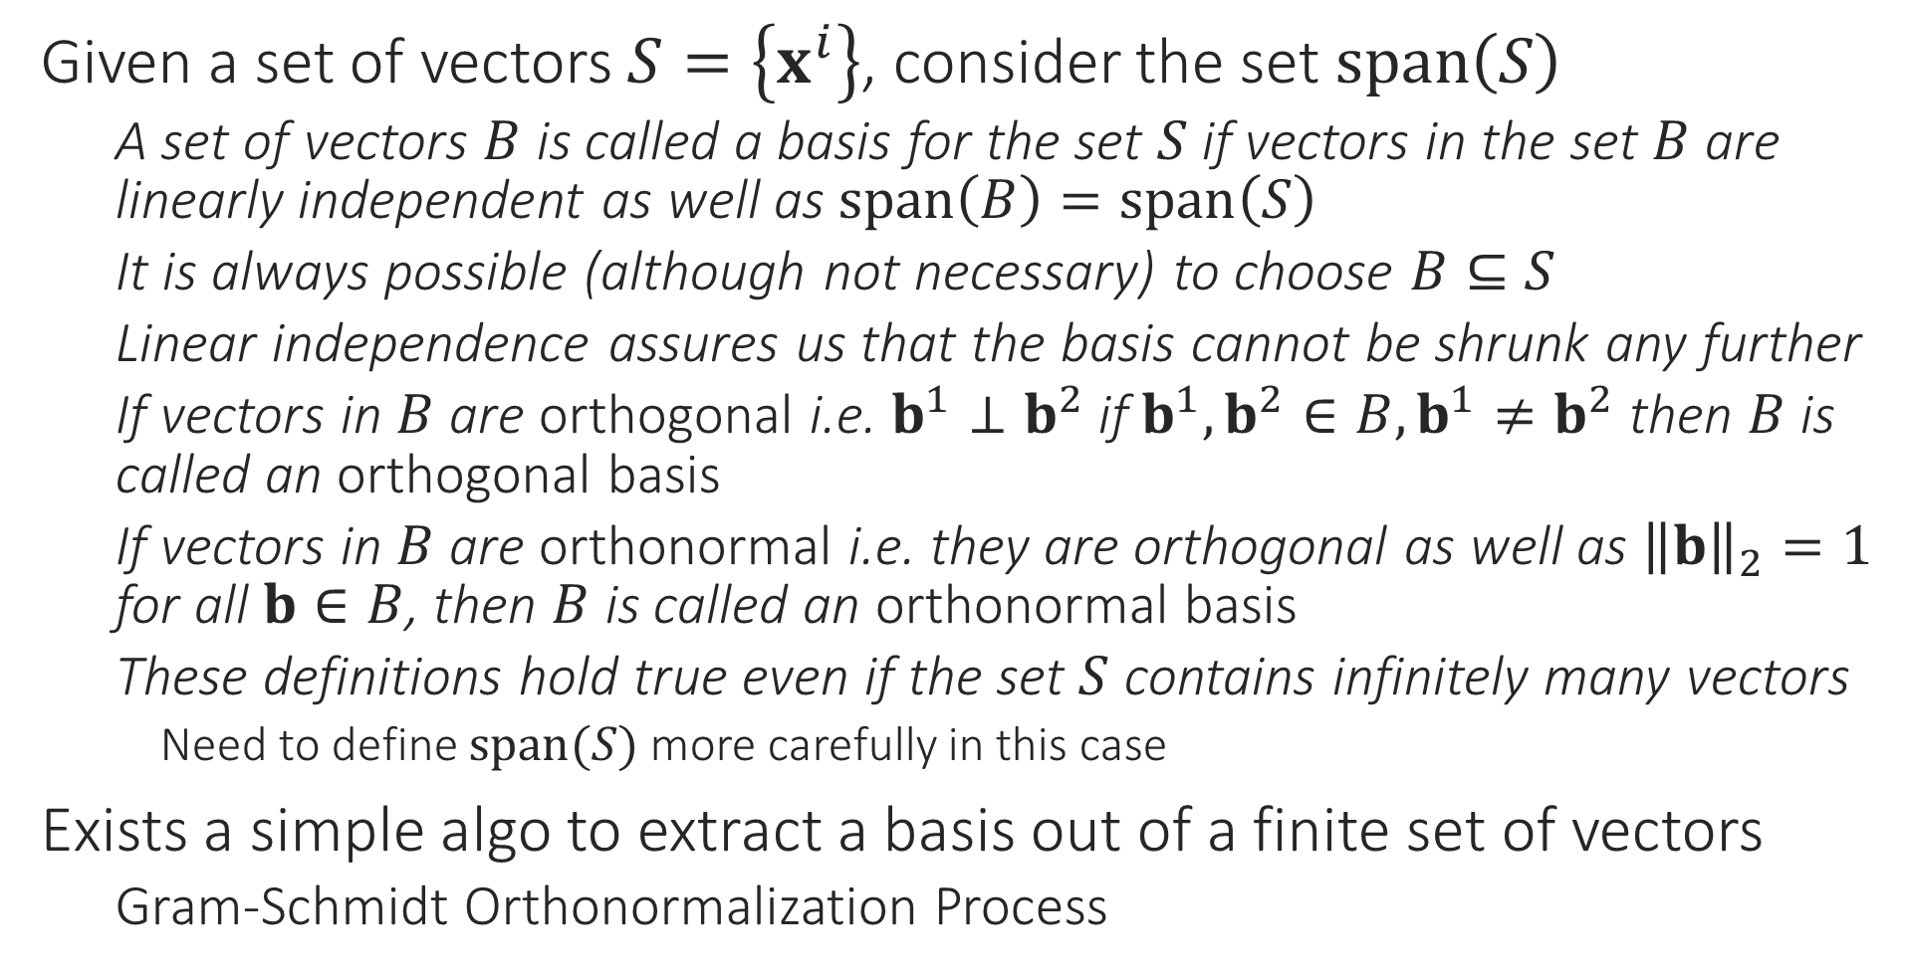
Basis
Given a set of vectors $S=\left\{x^{i}\right\}$, consider the set $span\left(S\right)$
A set of vectors $B$ is called a basis for the set $S$ if vectors in the set $B$ are linearly independent as well as $span\left(B\right)=span\left(S\right)$
It is always possible (although not necessary) to choose $B⊆S$
Linear independence assures us that the basis cannot be shrunk any further
If vectors in $B$ are orthogonal i.e. $b^{1}⊥b^{2}$ if $b^{1},b^{2}∈B, b^{1}≠b^{2}$ then $B$ is called an orthogonal basis
If vectors in $B$ are orthonormal i.e. they are orthogonal as well as ${\left\|b\right\|}_{2}=1$ for all $b∈B$, then $B$ is called an orthonormal basis
These definitions hold true even if the set $S$ contains infinitely many vectors
Need to define $span(S)$ more carefully in this case
Exists a simple algo to extract a basis out of a finite set of vectors
Gram-Schmidt Orthonormalization Process

Slide 10
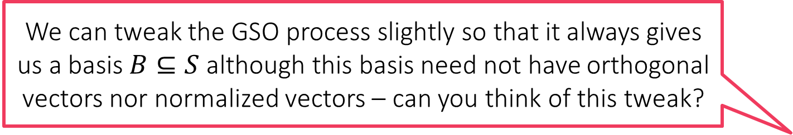
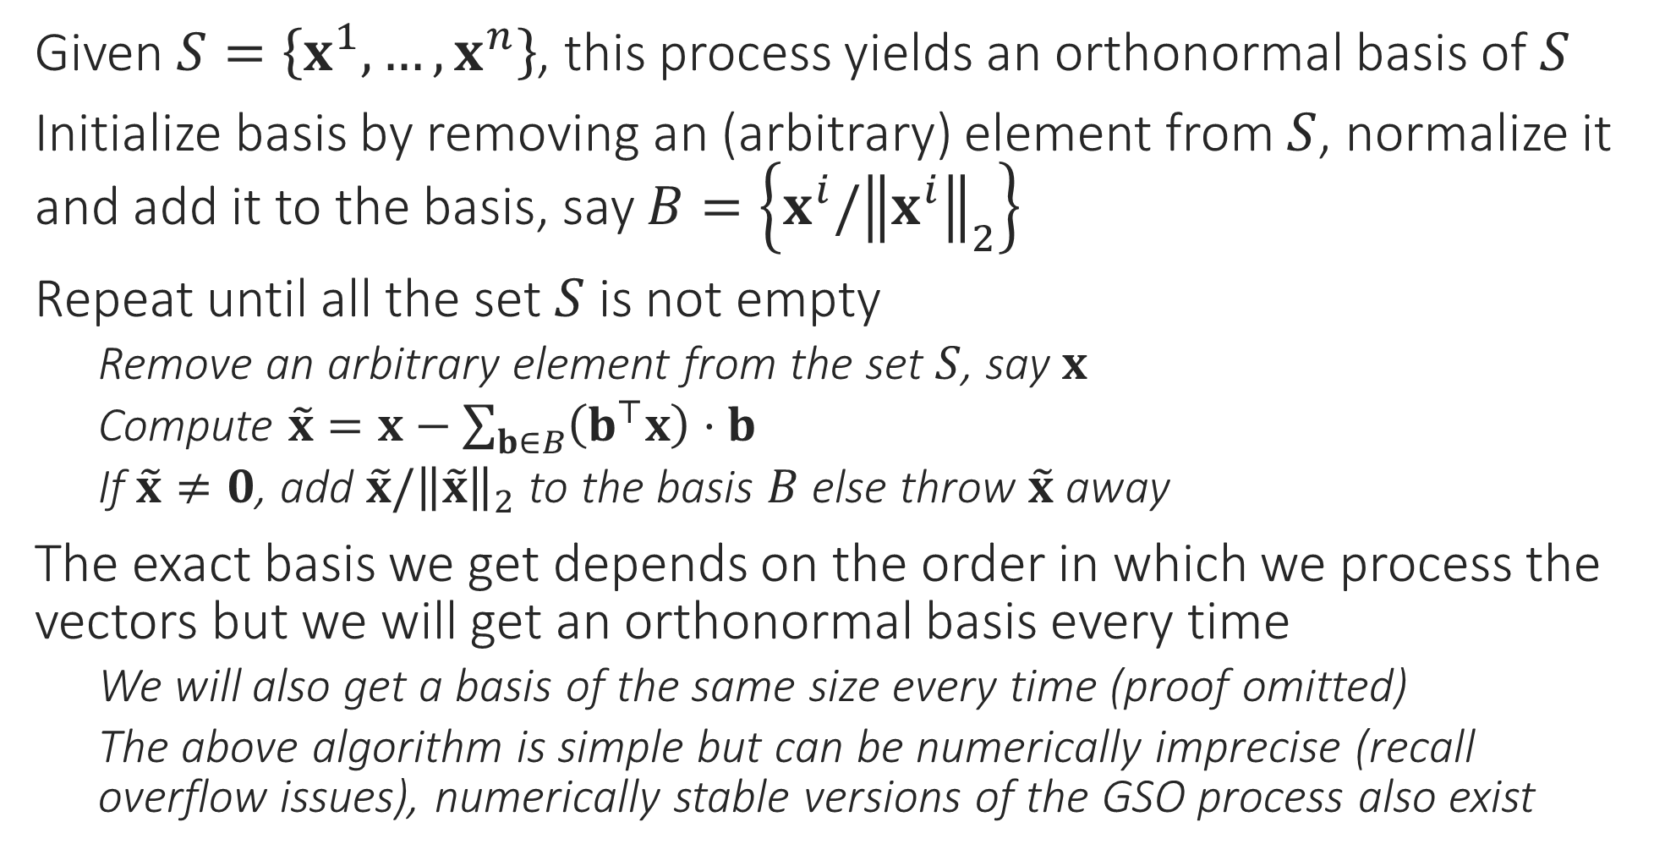
Gram-Schmidt Orthonormalization Process
We can tweak the GSO process slightly so that it always gives us a basis $B⊆S$ although this basis need not have orthogonal vectors nor normalized vectors – can you think of this tweak?
Given $S=\left\{x^{1},…,x^{n}\right\}$, this process yields an orthonormal basis of $S$
Initialize basis by removing an (arbitrary) element from $S$, normalize it and add it to the basis, say $B=\left\{x^{i}/{\left\|x^{i}\right\|}_{2}\right\}$
Repeat until all the set $S$ is not empty
Remove an arbitrary element from the set $S$, say $x$
Compute $\tilde{x}=x−\sum_{b∈B}{\left(b^{⊤}x\right)}⋅b$
If $\tilde{x}≠0$, add $\tilde{x}/{\left\|\tilde{x}\right\|}_{2}$ to the basis $B$ else throw $\tilde{x}$ away
The exact basis we get depends on the order in which we process the vectors but we will get an orthonormal basis every time
We will also get a basis of the same size every time (proof omitted)
The above algorithm is simple but can be numerically imprecise (recall overflow issues), numerically stable versions of the GSO process also exist

